Slide 1
Introduction to Markov Models
Kasthuri Kannan, PhD
Assistant Professor of Pathology
New York University

Slide 2
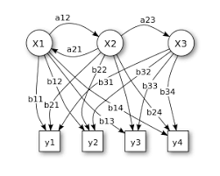
Overview of Topics
Introduction to Markov Processes
Hidden Markov Models
Forward Algorithm
Viterbi Algorithm
Tutorial

Slide 3
Introduction to Markov Processes
Interested in finding patterns appearing over time
Sequence of events
Appear in many areas in nature
Biological sequences (DNA, RNA, Proteins etc.)
Sequences of words, natural language processing
Weather phenomenon etc.
Interested in knowing if the sequences makes useful patterns which can be modeled

Slide 4
Introduction to Markov Processes
Sequence of traffic lights – red - red/amber – green – amber – red.
Can be viewed as a trellis diagram
Each state is dependent solely on previous state (deterministic system) – observable Markov process
Stop
Prepare to go
Go
Prepare to stop

Slide 5
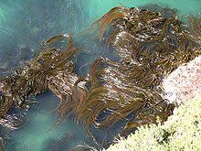
Introduction to Markov Processes
Deducing weather from a piece of seaweed
Soggy Sun
Damp means can’t be sure
Note: State of the weather is not
dependent on the state of the
seaweed so we can say something (like raining)
Another clue would be the state in the preceding day
– by combining this knowledge we will be able to come to a better forecast

Slide 6
Introduction to Markov Processes
Consider systems which generate probabilistic patterns in time – such as weather fluctuating between sunny and rainy, or signal going from amber to red
We the look at systems where what we wish to predict is not what we observe
– the underlying hidden system
In seaweed example, the hidden system would be the actual weather
In traffic light example, the hidden system could be the actual signal while observed sequence would be traffic (cars, busses) stopping or moving

Slide 7
Introduction to Markov Processes
Some problems can be solved once the system is modeled
What the weather was for a week given each day’s seaweed observation
Given a sequence of seaweed observations, is it winter or summer?
Intuitively if the seaweed has been dry for a while it may be summer, else, otherwise

Slide 8


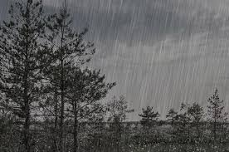
Introduction to Markov Processes
Typically we build trellis diagram – each state depending only on the previous state
Weather example: each sequence taking a single day (with self-transition) – one possible sequence

Slide 9
Introduction to Markov Processes
All possible sequences

Slide 10
Introduction to Markov Processes
All possible sequences with probabilities
0.3
0.2
0.3
0.1
0.4
0.5
0.4
0.6
0.2
Note: Total of these colored probabilities equals 1

Slide 11
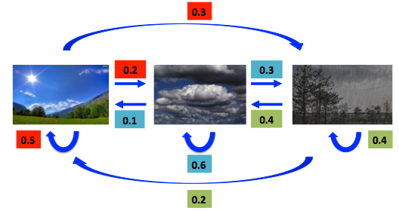
Introduction to Markov Processes
All possible sequences with probabilities
 | Sunny | Cloudy | Rainy
Sunny | 0.5 | 0.2 | 0.3
Cloudy | 0.1 | 0.6 | 0.3
Rainy | 0.2 | 0.4 | 0.4
Transition Matrix
Note: Total of these colored probabilities equals 1

Slide 12
Introduction to Markov Processes
Many cases the patterns are not apparent
A crab may have access only to the seaweed and not the weather – although weather and seaweed states are closely linked
Two set of states
Observable states (seaweed)
Hidden states (the state of the weather)
Devise an algorithm for the crab to forecast weather from the seaweed and Markov assumption without actually ever seeing the weather

Slide 13
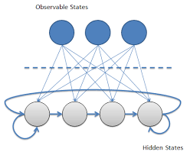
Hidden Markov Models
Observed sequence of states is probabilistically related to hidden states
Hidden Markov Models – modeling such processes where set of observable states are somehow related to hidden states
– with Markov assumption
Number of hidden states may be different from number of observable states
Seaweed States
Dry
Soggy
Damp
Sunny
Rainy
Cloudy
Humid
Weather States

Slide 14
Hidden Markov Models
Observable States
Soggy
Damp
Dryish
Dry
Hidden States

Slide 15
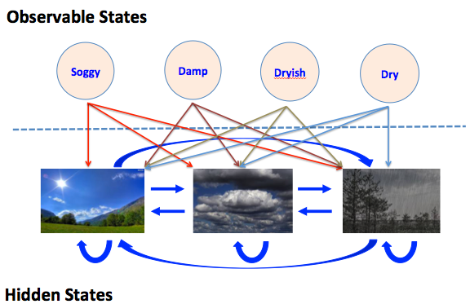
Hidden Markov Models
Hidden states are modeled by simple first order Markov process
The connections between
hidden states and
observable states
represent the probability
of generating a
particular observed
state given that the Markov
process is in a particular
hidden state
Probabilities “entering” an observable state will sum up to 1, since it would be the sum of Pr(Obs|Sun), Pr(Obs|Cloud) and Pr(Obs|Rain)

Slide 16
Hidden Markov Models
Apart from the transition matrix we also have emission matrix which contains the probabilities of the observable states given a particular hidden state.
Note: sum of each matrix row is 1
Probabilities in transition and emission matrices are time independent – i.e., they don’t change over time
One of the most unrealistic assumptions of Markov models when applied to real process.
Seaweed State Today
 | Dry | Dryish | Damp | Soggy
Sunny | 0.6 | 0.2 | 0.15 | 0.05
Cloudy | 0.25 | 0.25 | 0.25 | 0.25
Rainy | 0.05 | 0.10 | 0.35 | 0.5
Weather Yesterday
Emission matrix/probabilities

Slide 17
Hidden Markov Models
Evaluation (pattern recognition) – Finding the probability of an observed sequence given a HMM
Decoding (pattern recognition) – Finding the sequence of hidden states that most probably generated an observed sequence
Learning – Generating a HMM given a sequence of observations

Slide 18
Hidden Markov Models - Evaluation
Number of HMMs describing different systems and sequence of observations
Which HMM most probably generated the given sequence
Example, a “summer” and “winter” model for seaweed behavior to determine season
Usually carried out by forward algorithm to calculate the probability of an observation sequence given a HMM and choose the most probable HMM

Slide 19
Hidden Markov Models - Decoding
Find the most probable sequence of hidden states given some observations
In several instances we are interested in identifying the hidden states since they represent something of value
For example, chromatin states, CpG islands etc.
In our own example, identifying the weather only knowing the status of the seaweed
Viterbi’s algorithm is handy for this process.

Slide 20
Hidden Markov Models - Learning
Involves generating a HMM from a sequence of observations
Take a sequence of observations (from a known set), known to represent a set of hidden states and fit the most probable HMM
Baum-Welch expectation maximization (EM) can be used to identify local optimal parameters for the HMM for the Learning problem

Slide 21
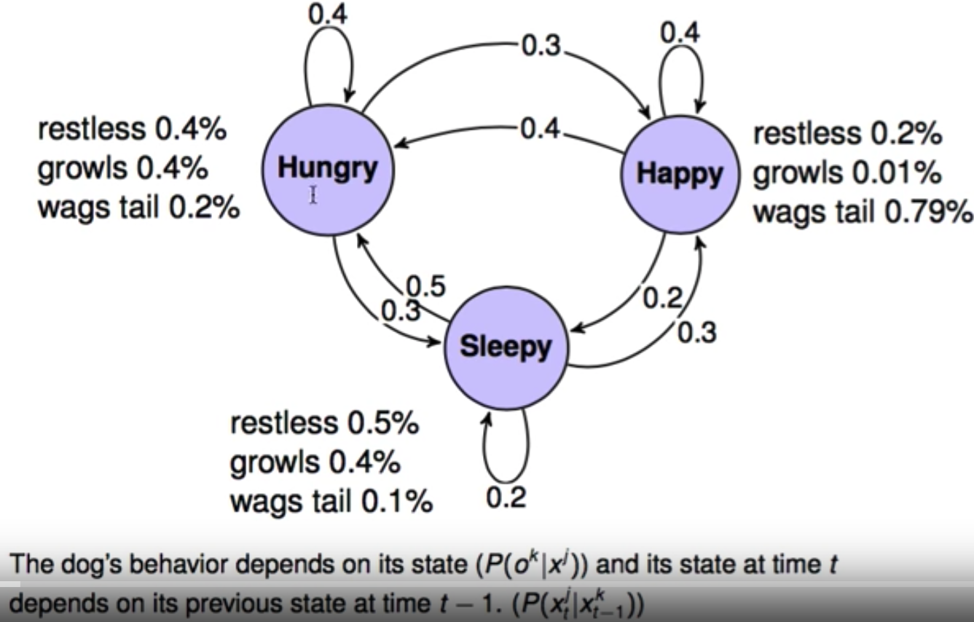
The Forward Algorithm
A real world example

Slide 22
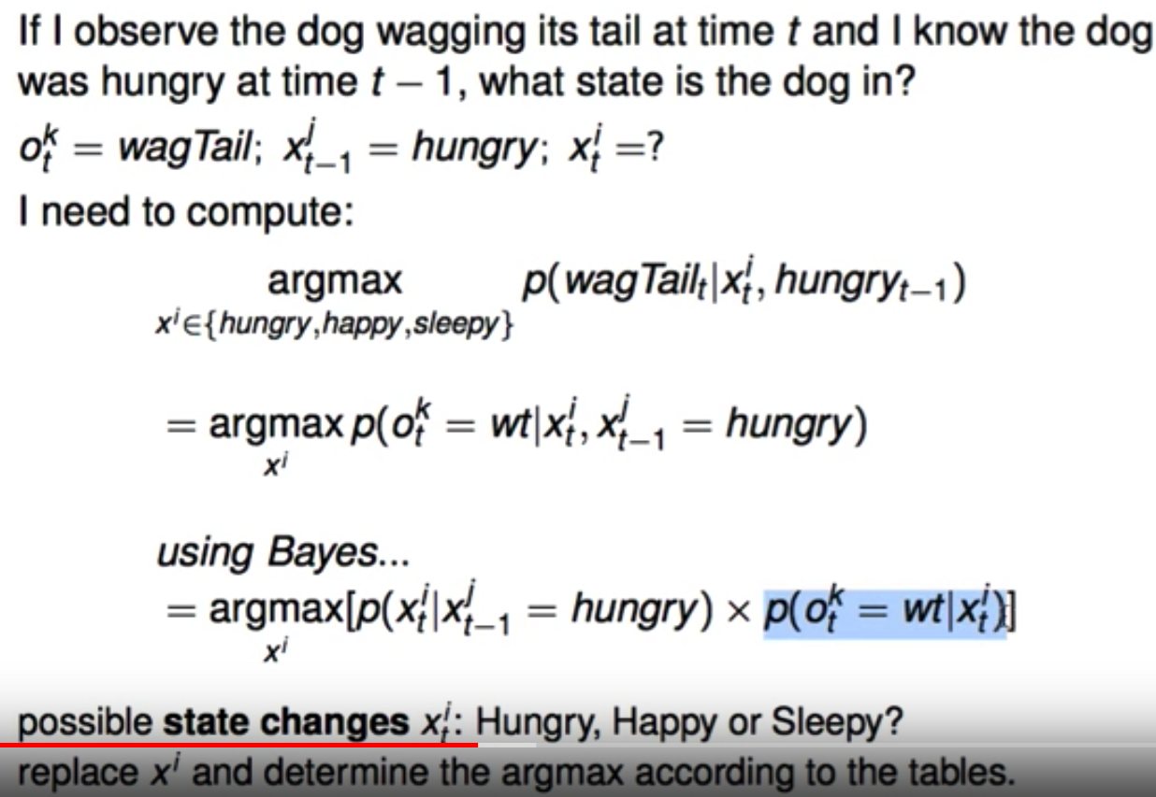
The Forward Algorithm
Predicting the state after n observations

Slide 23
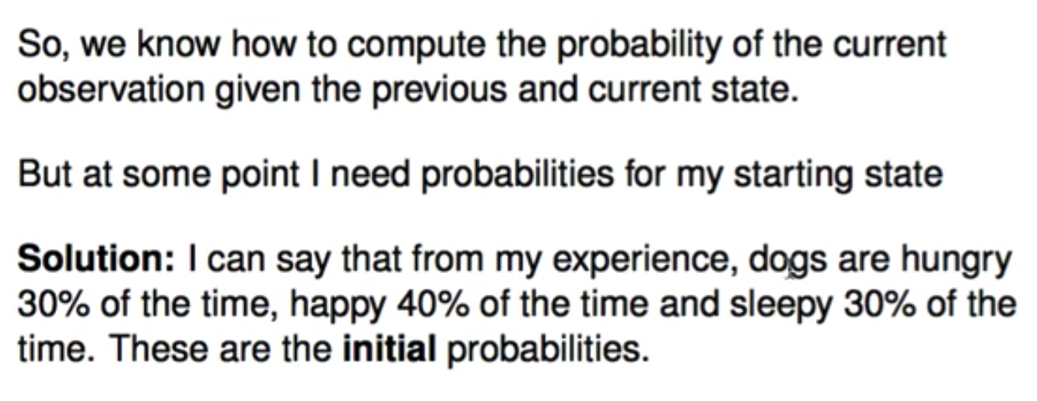
The Forward Algorithm
Predicting the state after n observations

Slide 24
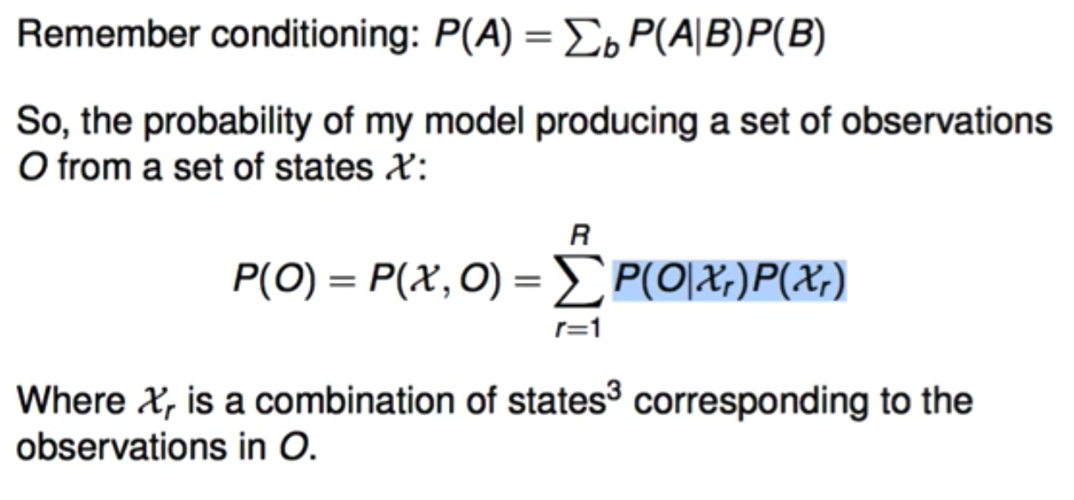
The Forward Algorithm
Predicting the state after n observations

Slide 25
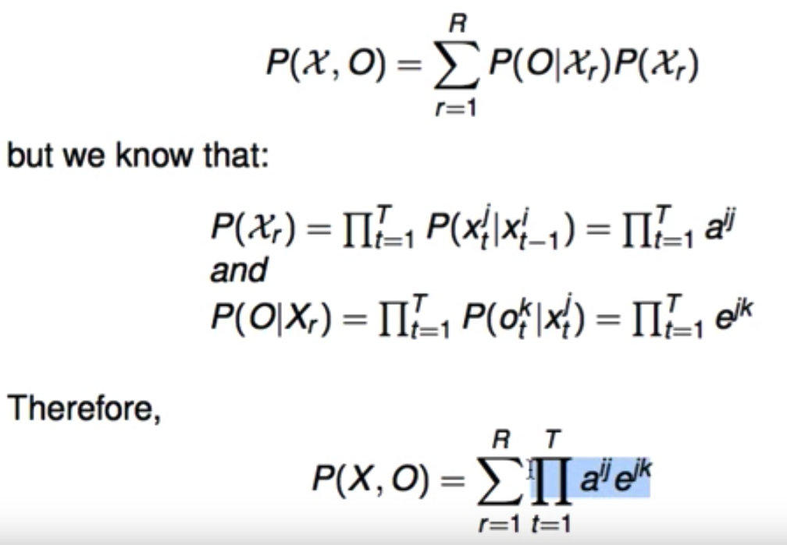
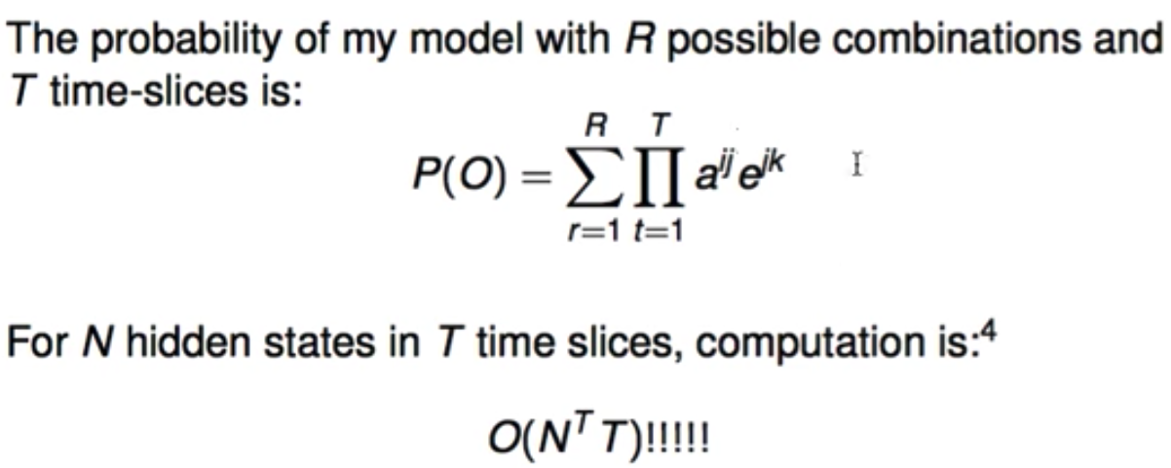
The Forward Algorithm
Predicting the state after n observations

Slide 26
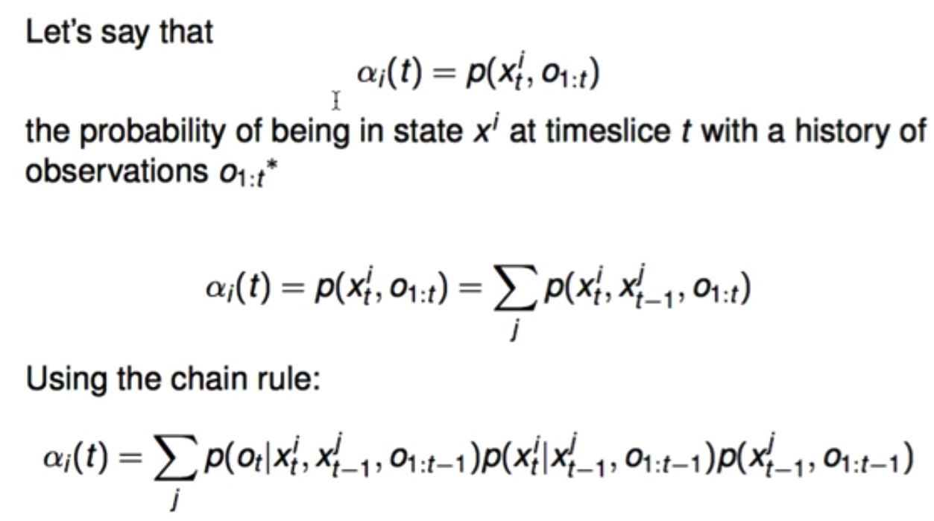
The Forward Algorithm
Building computations one at a time

Slide 27
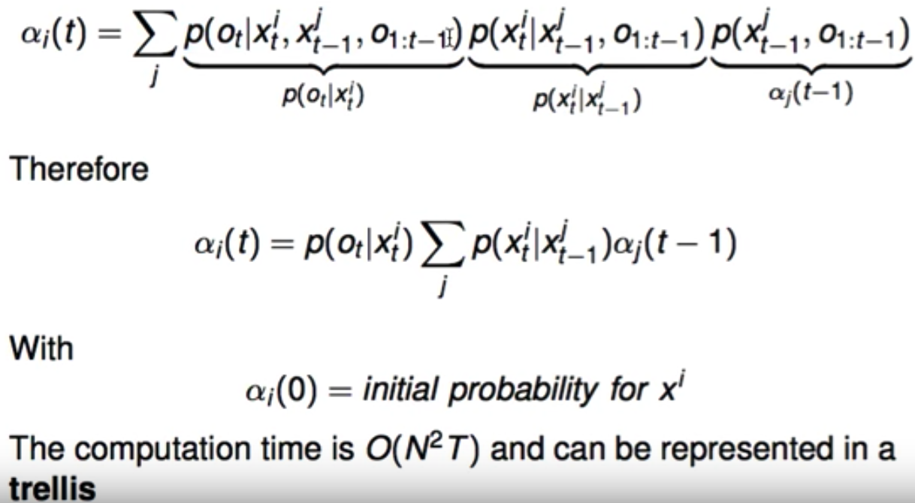
The Forward Algorithm
Building computations one at a time

Slide 28
The Forward Algorithm
Trellis for the states of the dog given observations

Slide 29
The Forward Algorithm
Trellis for the states of the dog given observations

Slide 30
The Forward Algorithm
Trellis for the states of the dog given observations

Slide 31
The Decoding Problem
Most probable sequence of states given observations
Viterbi’s Algorithm
https://www.youtube.com/watch?v=6JVqutwtzmo&t=178s

